Slide 1
GROCERY EXPRESS
Our Product Meets Your Needs

Slide 2
Group members
DHARMIL KOTAK 186090307023
AAYUSH PARMAR 186090307034
VRAJ PUJARA 186090307044
JAYDIPSINH ZALA 186090307059
Guided by: Mr. Pratik B. Parmar

Slide 3
INTRODUCTION
This website is mainly made for buying the goods and house hold items at your doorstep just from your device.
instead of visiting to the shop or market, wasting time and carrying such heavy things our Grocery Express solves all those problems and make your life easy, comfortable and stress-free. This site provides cheapest, qualifiable and fresh products with lots of offers and discounts.

Slide 4
PROJECT SUMMARY
First User can create his/her registration account and user can login to this web app.
User login his/her account and then they can buy product from our website.
Generally the visitors who had not registered or doesn't had a membership they can't buy the product, they can only make a Wishlist or can do 'Add to cart'.
Only registered candidates can use this Website for buying the products.

Slide 5
SCOPE
This website is simply an interface between seller and customer or we can say buyers.
During festival seasons we generally see crowdy shops and face the problem of black-marketing sit we have to compromise the quality of product but we provide the solution of all those has tic and irritating problems.
There are three types of users for current system:
1. Admin
2. User1
3. Delivery Boys

Slide 6
PURPOSE
This website will be helpful for all the customer for buying the product from any remote area of their need and of best quality.
Goal:
Delivering the product at your home with short duration of time.
It saves the time instead of going to market you can order it simply from your device.
Objectives:
Our aim is to save the time, efforts, money of our customers.
Providing an online portal of ordering your product like rest of e-commers items.

Slide 7
TECHNOLOGY
FRONT END:- PHP, HTML, Vanilla JavaScript
PHP, as a scripting language, is popular among web developers because of its ability to interact with database systems including Oracle and MySQL.
Any website can require a variety of data or information to display and to retrieve them from the database.
Easy from development point of view.
Higher productivity.
Vanilla JavaScript is light weight, pre-installed on almost all browsers and very useful to change web page content without refreshing it.

Slide 8
BACK END:- MySQL
Programming skills are not required to use MySQL as database management.
And it is also free and open source with great community support.
It provides better security and data recovery against system failure.
MySQL works faster compared to other Database Management tools. phpmyadmin GUI to work with MySQL, because of its GUI environment it is very easy to understand any novice user.

Slide 9
Hardware requirement
500 GB Hard Disk Drive
Intel i3 dual core processor generation: 7th or Ryzen 3
8 mega pixel camera or already taken grocery photo
Software requirement
Operating System: Windows 10
Browsers: Google Chrome, Mozilla Firefox, Microsoft Edge
Text Editor: VSCode, Sublime
Local Server: XAMPP

Slide 10
LITERATURE REVIEW
BIGBASKET : Deliver the product within 3-4 days.
it doesn’t deliver in small city or Ruler areas.
Link:- https://www.bigbasket.com
Our site’s advantage: We deliver products in same day and we do work for small city
GROFERS : They depend on stores that they tied-up with to provide them the items.
Link:- https://grofers.com
Our site’s advantage: customer order direct to the shop’s owner

Slide 11
Detailed requirement analysis
Admin
Can insert and modify all products.
Admin can keep the monitoring on the staff members he/she can analysis the whole company and can manage entire system.
Can register all delivery boys also manage them.
2. User1
Can buy the product as per their requirements and wish.
Can modify its profile details.
Can check his/her order history
3. Delivery Boys
They deliver the orders at right place in the time limits.

Slide 12
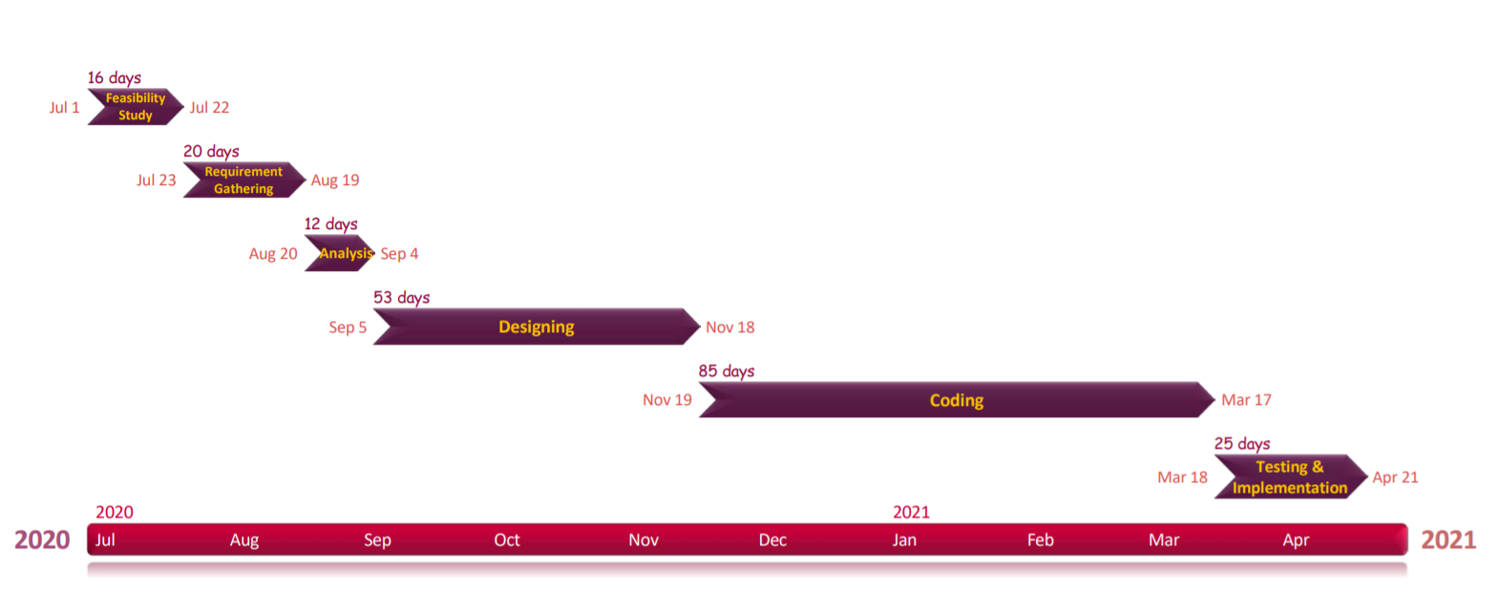
Project Planning and scheduling

Slide 13
DEVELOPMENT APPROACH
Incremental model
It is also referred as the successive version of waterfall model using incremental approach and evolutionary model.
In this model, the system is broken down into several modules which can be incrementally implemented and delivered.
First develop the core product of the system. The core product is used by customers to evaluate the system.
The initial product skeleton is refined into increasing levels of capability by adding new functionalities in successive versions.

Slide 14
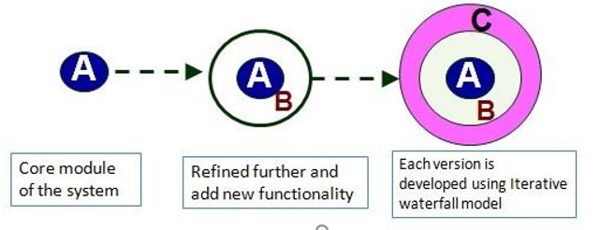
INCREMENTAL MODEL

Slide 15
Software Requirement Specification
User
1. Sign up
1.1 open website
I/p=Type URL in any browser
0/p=website appears
1.2Goto sign up page
I/p=Click on sign up
0/p=sign up page appears
1.3 sign up
I/p=enter valid data and click sign up
0/p=your id is created

Slide 16
2. Profile
2.1 Open web site
I/p=Type URL in any browser
0/p=website appears
2.2 Log in
I/p=Type user credential on log in page
0/p=log in
2.3 go to Profile page
I/p=select 'profile’ in user[drop down] menu
0/p=profile page appears with user data
2.4 Edit profile
I/p=change desired credentials and click update
0/p=profile is update

Slide 17
3. Order
3.1 Open web site
I/p=Type URL in any browser
0/p=website appears
3.2 Log in
I/p=type user credential on log in page
0/p=log in
3.3choose items
I/p=add desired item in cart by entering amount of item and pressing button
0/p=item will be add in user cart
3.4 Review cart
I/p=check items and its amounts and click ‘order now’ button
0/p=confirmation box will appears
3.5 confirmation of order
I/p=check details and press ‘confirm’ button
0/p=order is successful

Slide 18
Delivery boy
1. Delivery Order Selection
1.1 Open web site
I/p=type URL in any browser
O/p=web site appears
1.2 Log in
I/p=type user credential on log in page
0/p=Logged in
1.3 Select order
I/p=go to pending orders page
0/p=select appropriate address and get details of that order
1.5deliver order
I/p=deliver order and click on ‘Delivered’ button
0/p=order is delivered

Slide 19
Admin
1. Insert Items
1.1 open web site
I/p=Type URL in any browser
O/p=web site appears
1.2 log in
I/p=type user credential on log in page
0/p=Logged in
1.3 Insert Items
I/p = Insert details, choose categories and press Insert button
O/p= Item inserted

Slide 20
2. View Order History
2.1 open web site
I/p=type URL in any browser
O/p=web site appears
2.2 log in
I/p=type user credential on log in page
0/p=logged in
2.3 Order History
I/p = Go to order history
O/p = Order History appeared

Slide 21
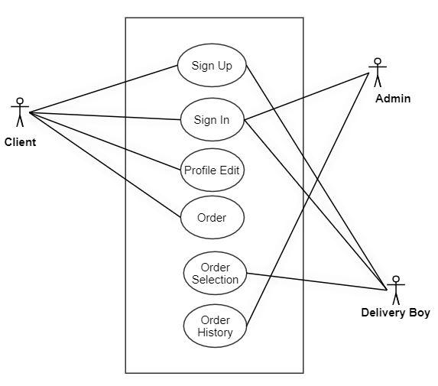
Use Case Diagram

Slide 22
Level 0 Data Flow Diagram
DATABASE
GROCERY EXPRESS
WEB APPLICATION
CLIENT
Order Bill
Analytical Data
ADMIN
Profile Update
Order Groceries
Verifies New Delivery Boys
Sign in
Level 0
Insert/Update Items
Order Request
DELIVERY BOY

Slide 23
Level 1 DFD for Sign Up
Loading
Web Application
Input Validation
WebApp URL
Data in Sign up
User ID Created
Successfully
DATABASE

Slide 24
Level 1 DFD for Profile
Open Website
Type URL
Type user
Credentials
Select profile in user menu
See your Profile
Update Your Details
Profile update
Log in
Edit Profile

Slide 25
Level 1 DFD for Order
Open Website
Type URL
Type user
Credentials
Log in
Add items in cart
Add to Cart
Select and
order it
Review Cart
Press ‘confirm’ button
Confirm order
Order Successful

Slide 26
Level 1 DFD for Delivery
Open Website
Select Order
Checks details and press Delivered button
Deliver Order
Type URL
Type user
Credentials
Log in
Goto Pending
orders
Order is delivered

Slide 27
Level 1 DFD for Insert Items
Open Website
Type URL
Insert details choose category
Type user
Credentials
Log in
Insert Items
Items Inserted

Slide 28
Level 1 DFD for Order History
Open Website
Type URL
Type user
Credentials
Go to
Order History
Order History
Order history Appeared
Log in

Slide 29
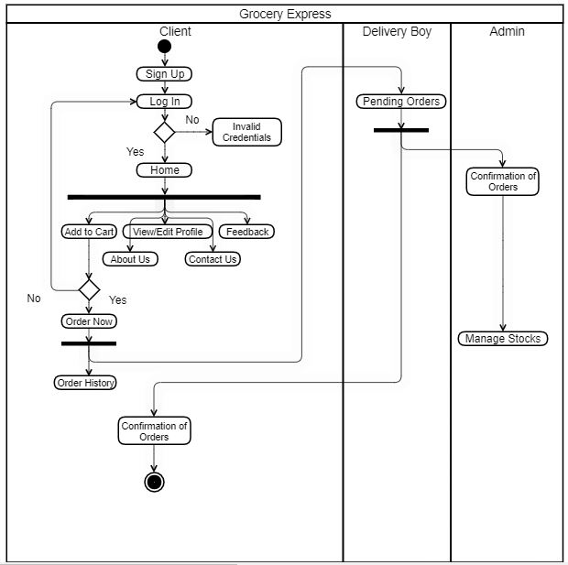
Activity Diagram

Slide 30
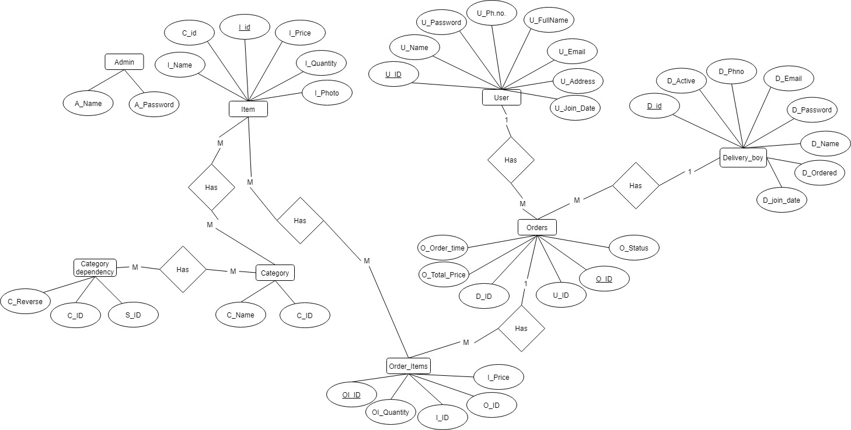
ER Diagram

Slide 31
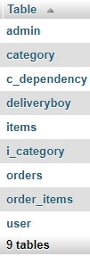
Data Dictionary

Slide 32
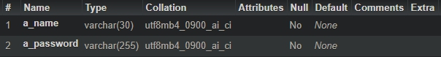
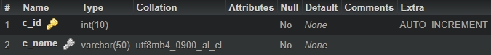
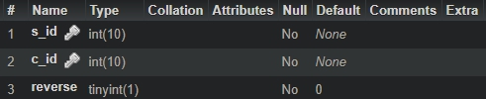
Admin
Category
C_dependency

Slide 33
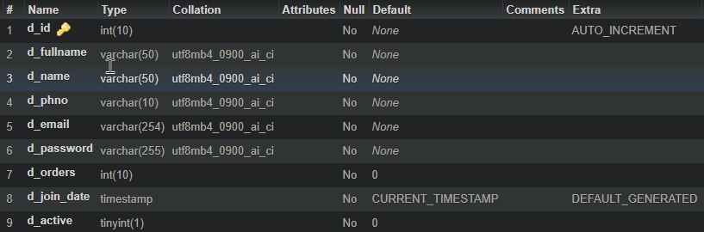
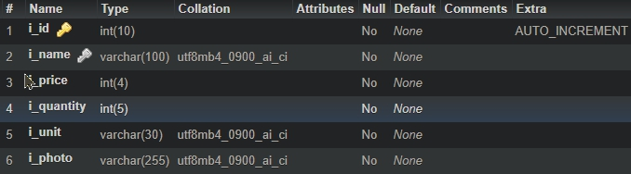
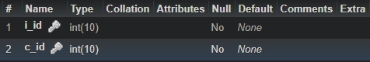
DeliveryBoy
Items
i_category

Slide 34
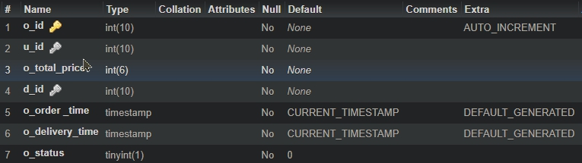
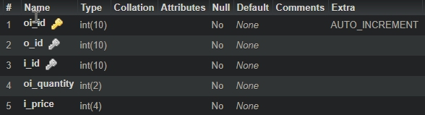
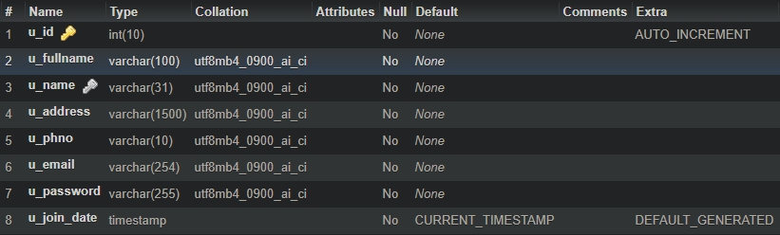
Orders
Order_items
User

Slide 35
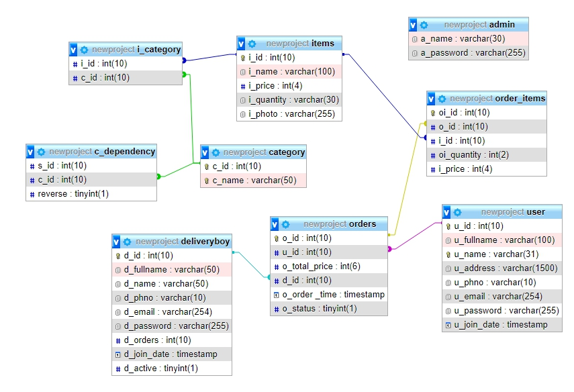
Relationships Between Tables

Slide 36
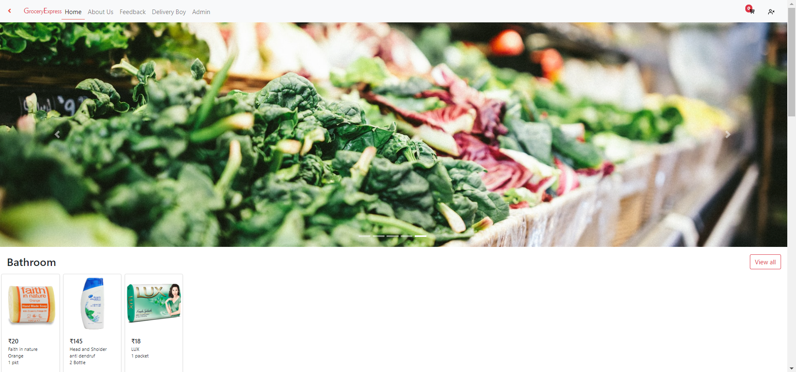
Customer side pages

Slide 37
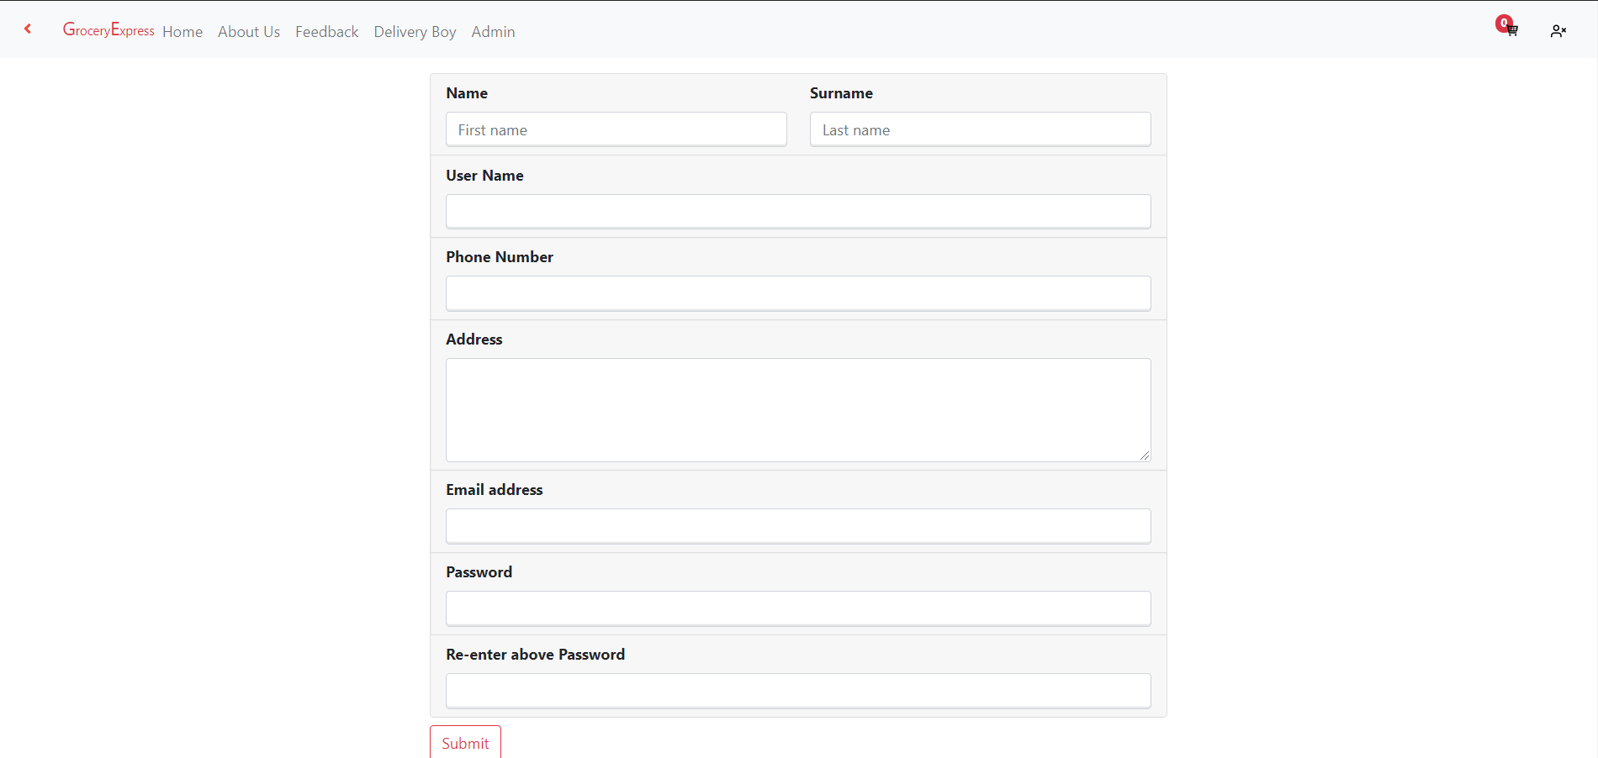
Customer sign in page

Slide 38
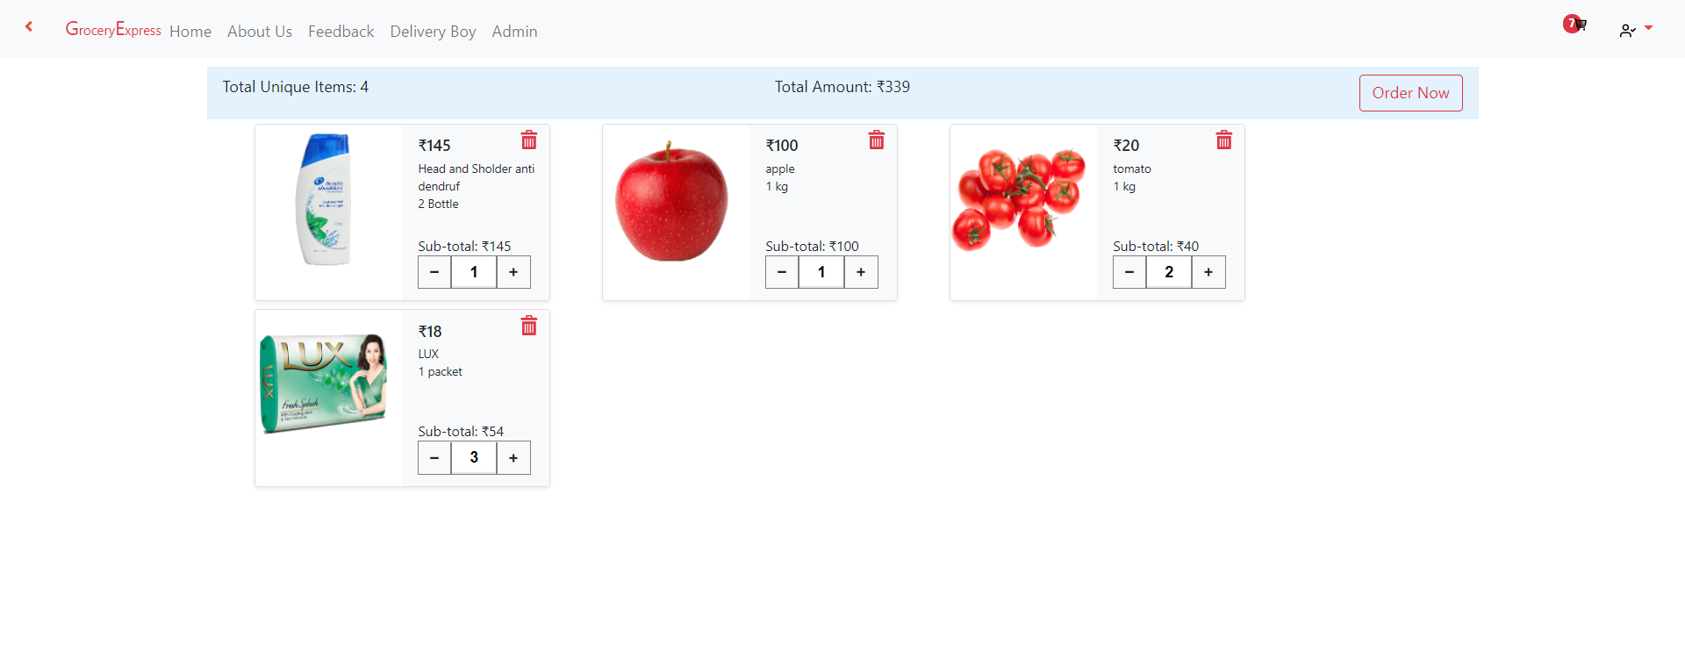
add to cart page

Slide 39
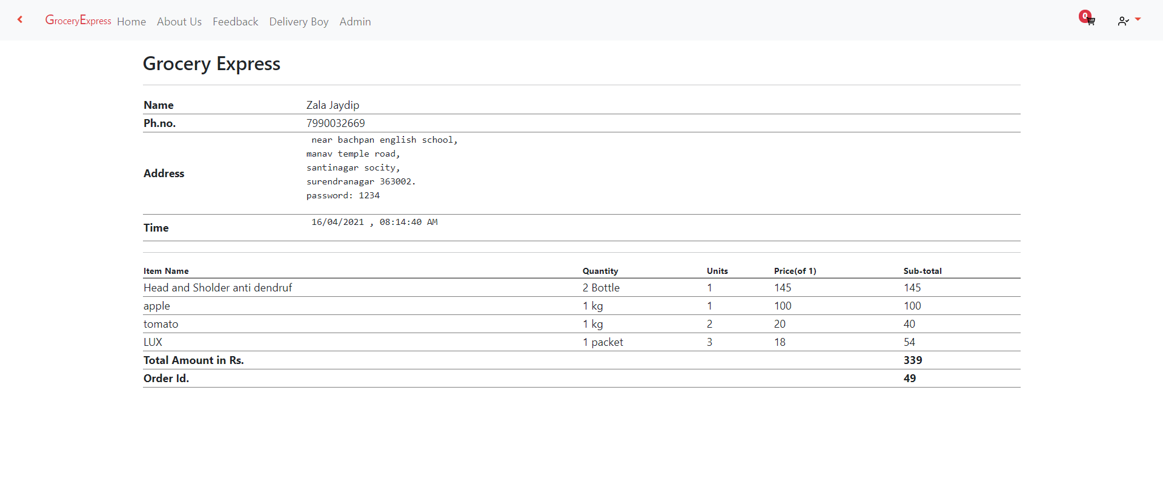
Bill page

Slide 40
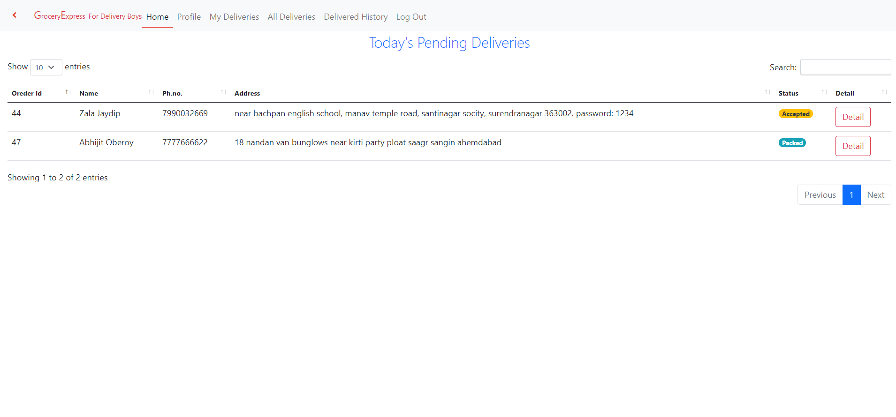
Delivery boy side pages

Slide 41
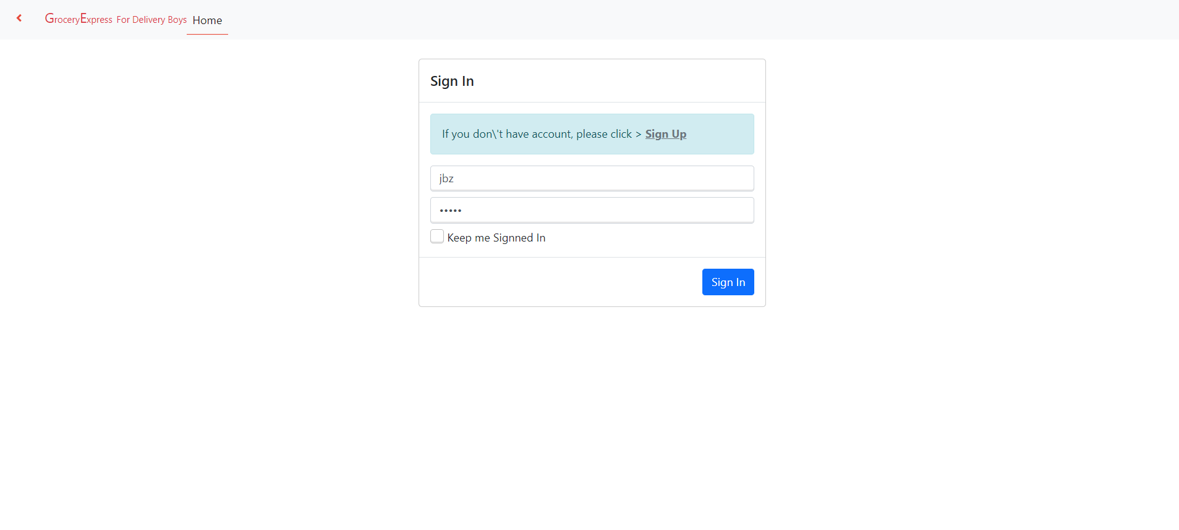
Dboy login

Slide 42
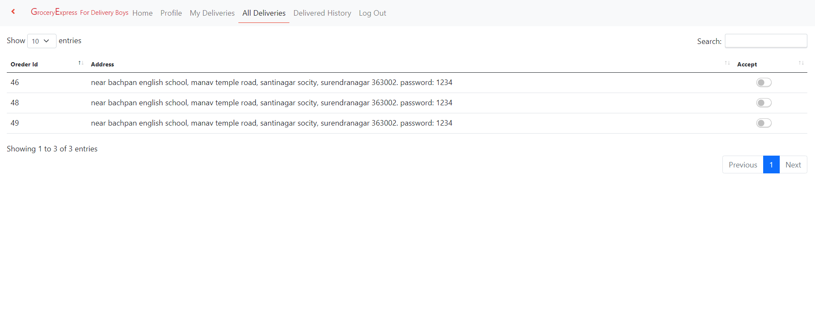
All deliveries

Slide 43
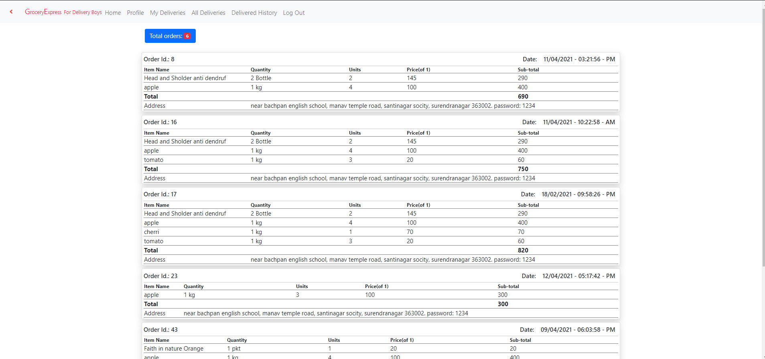
Dboy all deliveries

Slide 44
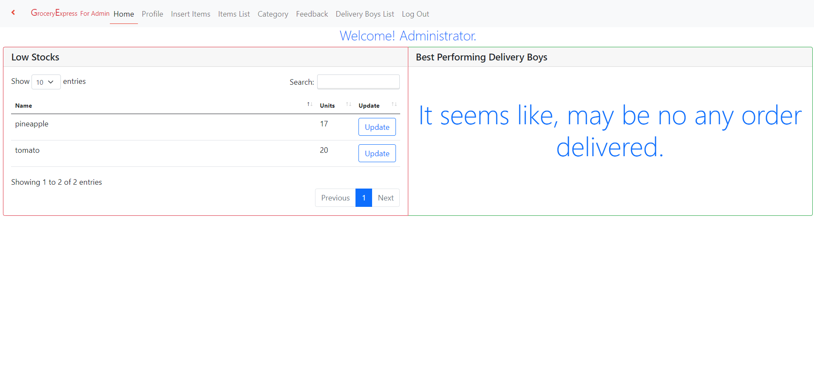
Admin side pages

Slide 45
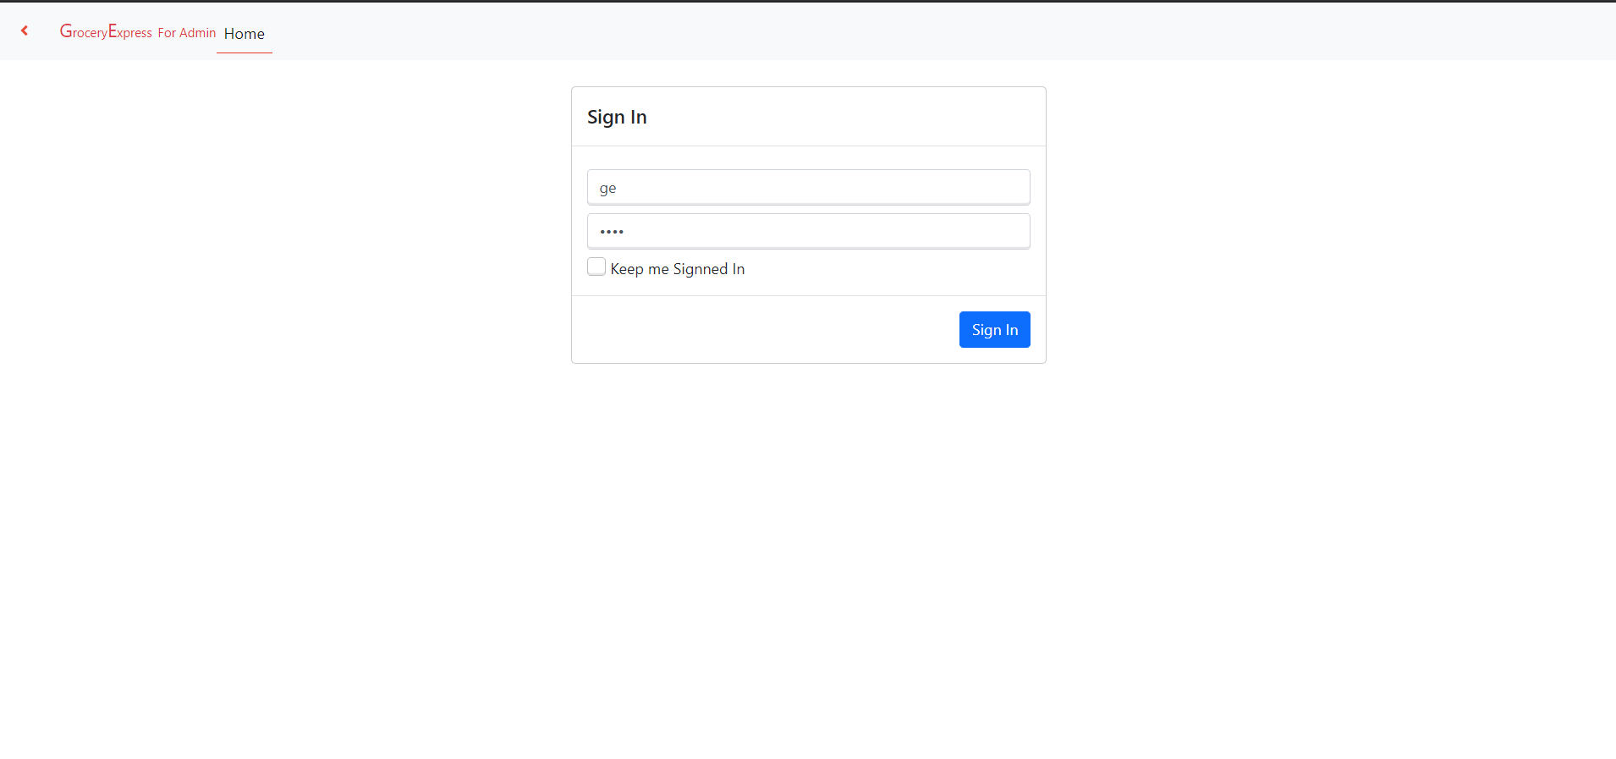
Admin login

Slide 46
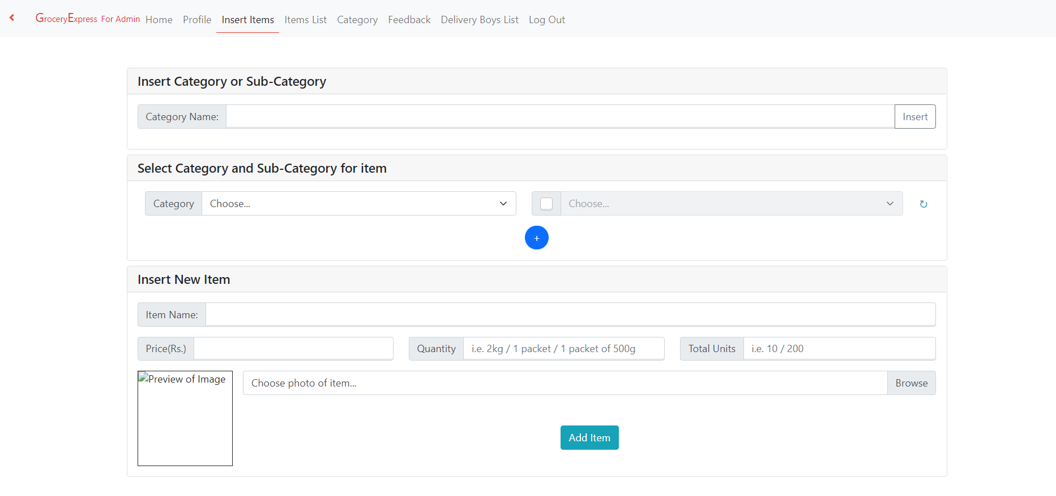
Insert items page

Slide 47
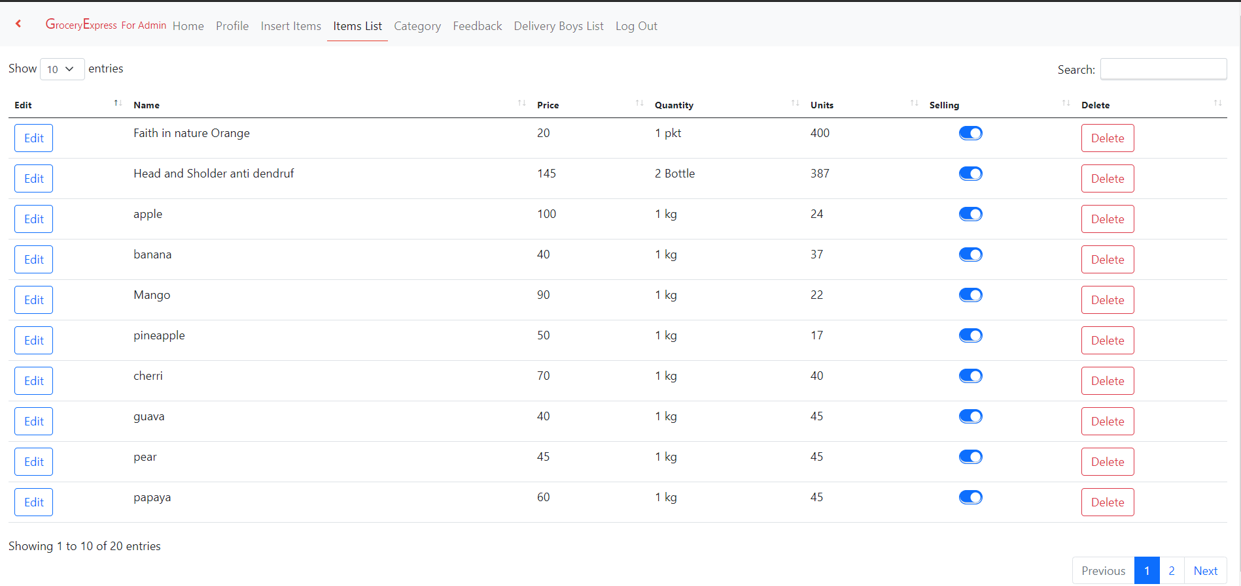
items list

Slide 48
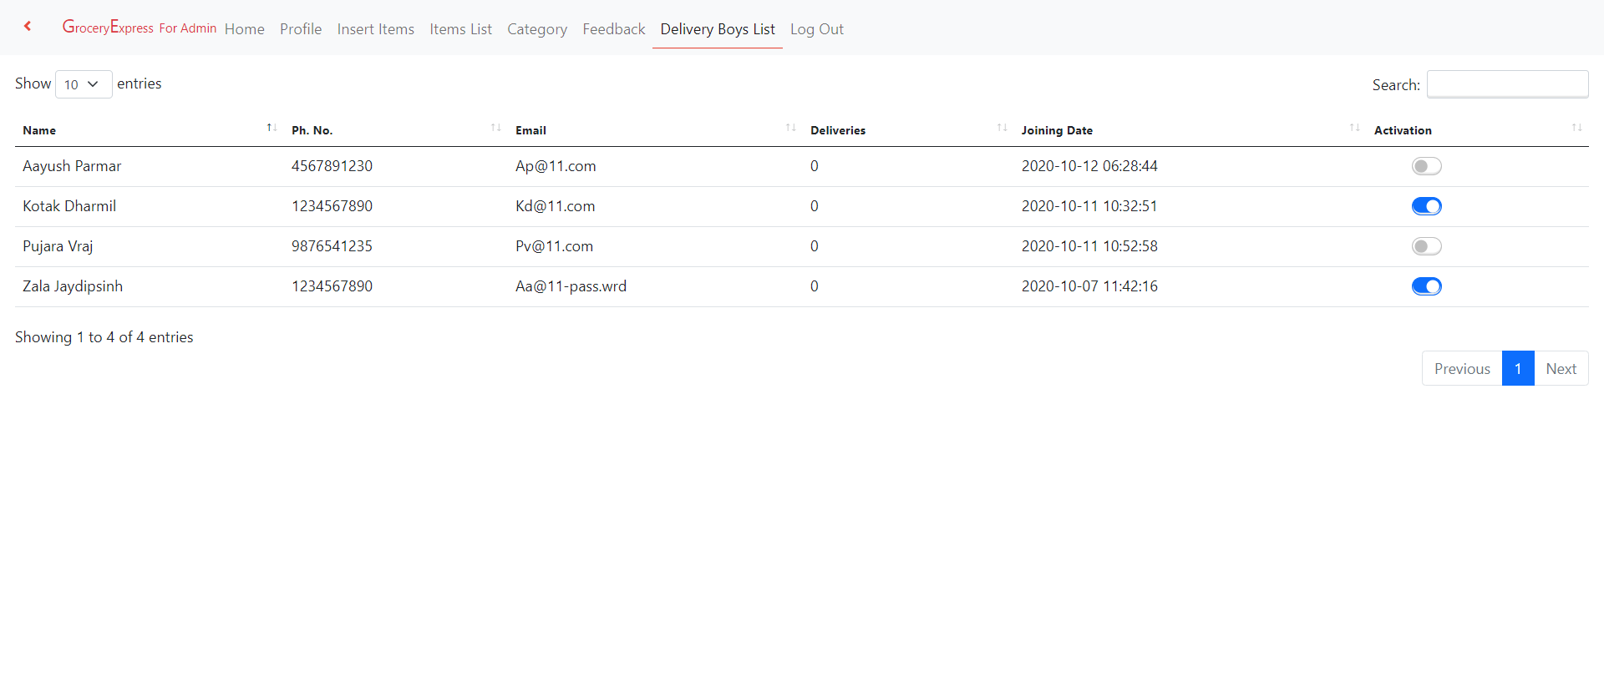
Delivery boys list

Slide 49
THANK YOU

